Slide 1
Flush + Reload side channel Attack
By Ricky Valdez and Samuel Youssef

Slide 2
Page Sharing
Page sharing allows two separate processes to access the same page stored in the cache
It is used for memory efficiency by eliminating identical pages stored in the cache
Since unrelated processes are sharing the content stored in cache, it leaves a process vulnerable to an attacker modifying that shared content from an external process

Slide 3
Copy-on-write
Copy-on-write only allows processes to read from shared content; if a process tries to write to shared content it instead gets interrupted, a copy of the shared content is created, and the writing process get mapped to the copy before it resumes the write operation
Although copy-on-write prevents attackers from modifying shared content, the delay that it creates from modifying a shared page can be detected by external processes, causing potential data leaks

Slide 4
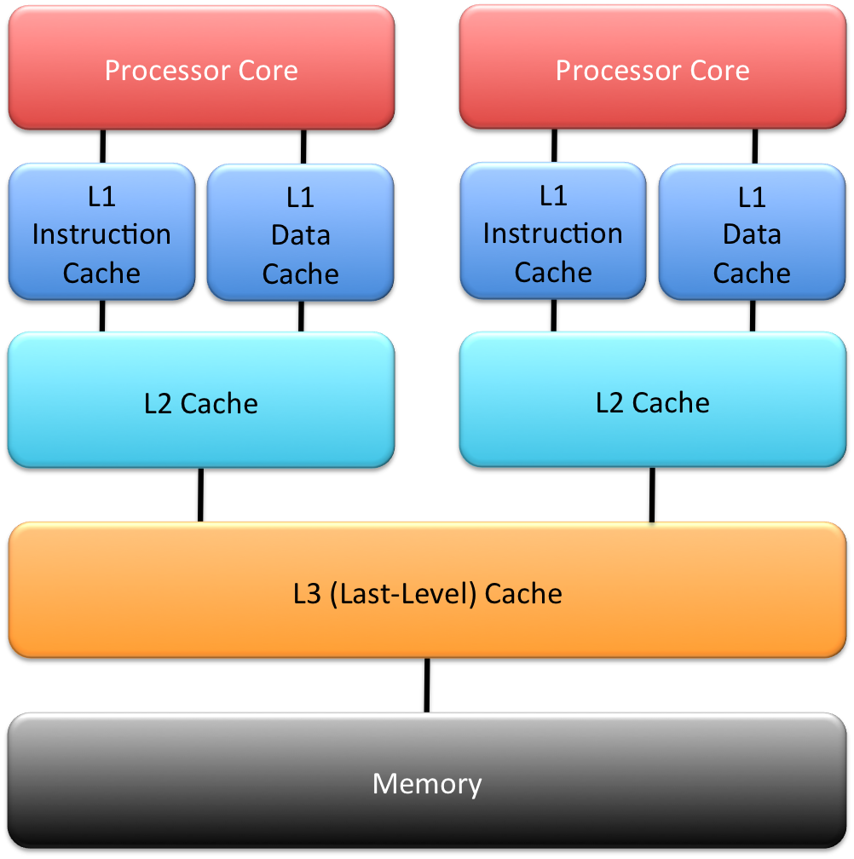
Cache architecture

Slide 5
Flush + reload Attack Stages
Flush – Clear out the monitored line from all cache levels
Wait – Allow time for the victim to access the line from memory
Reload – Load the line and measure the time it takes to load

Slide 6
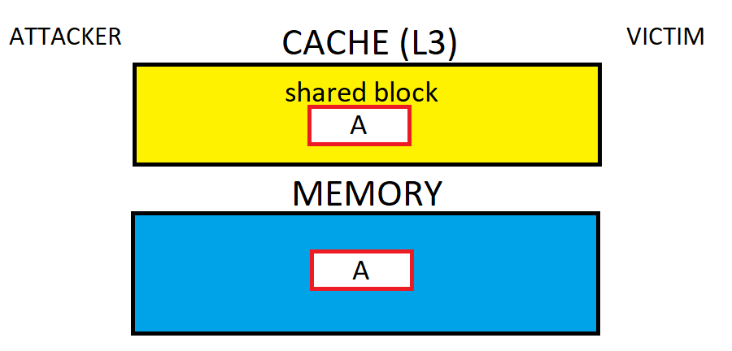
Flush + reload attack

Slide 7
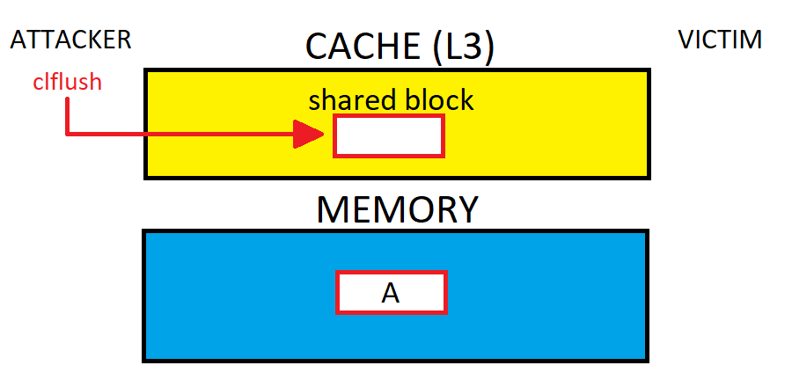
Flush + reload attack

Slide 8
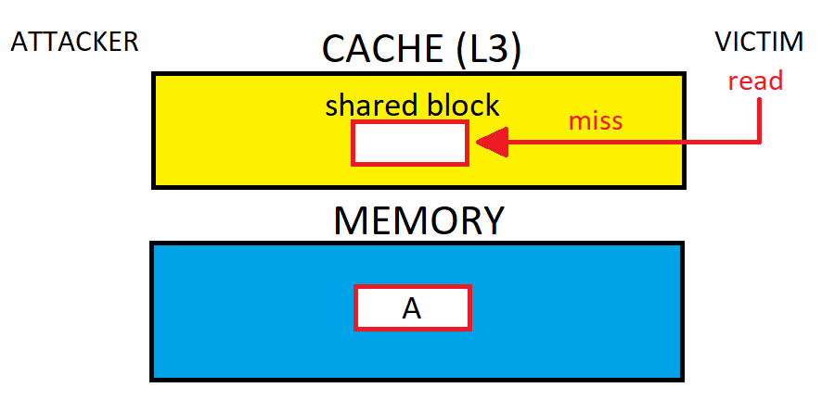
Flush + reload attack

Slide 9
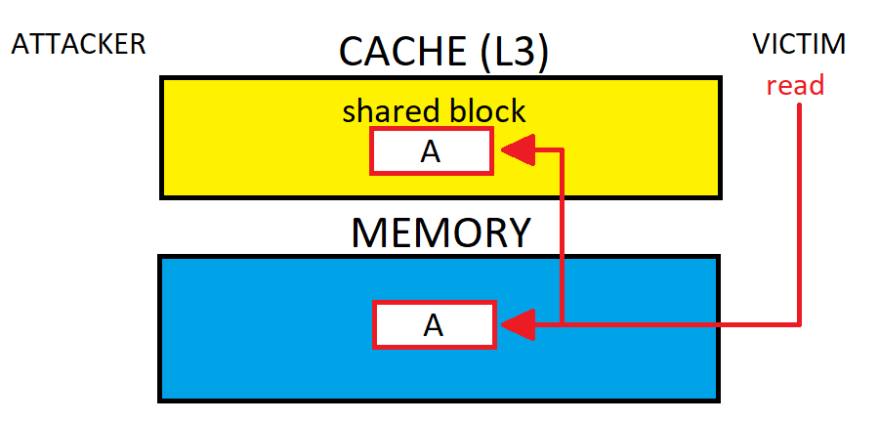
Flush + reload attack

Slide 10
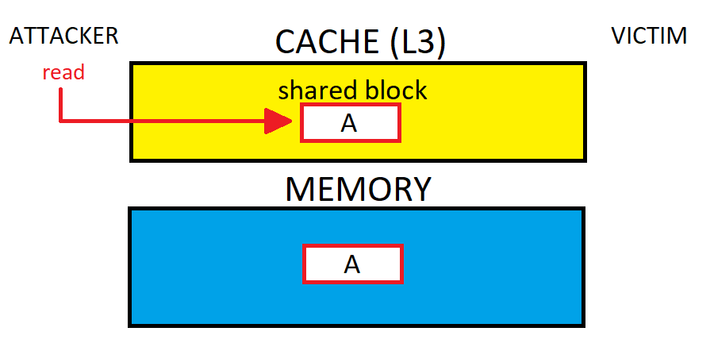
Flush + reload attack

Slide 11
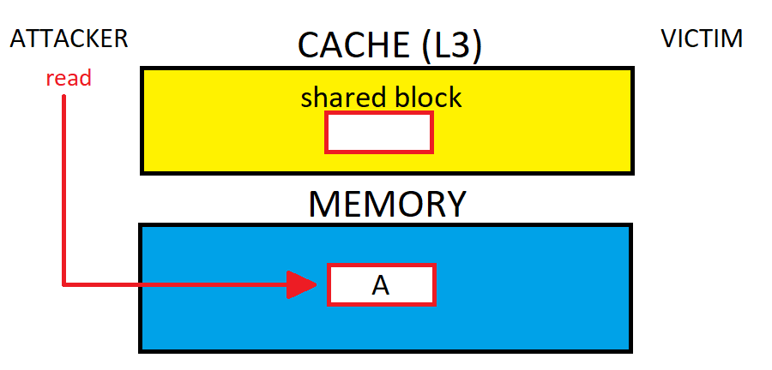
Flush + reload attack

Slide 12
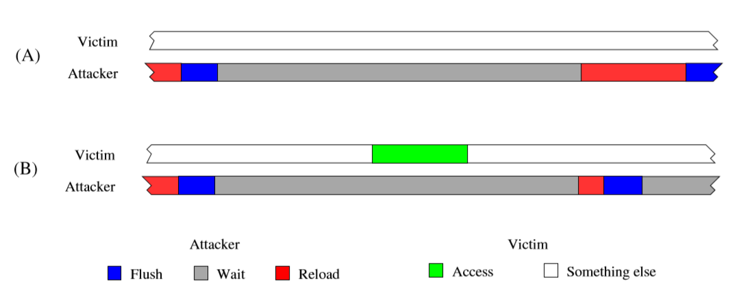
Flush + reload attack

Slide 13
Flush + reload applications
FLUSH+RELOAD: a High Resolution, Low Noise, L3 Cache Side-Channel Attack
Yuval Yarom and Katrina Falkner

Slide 14
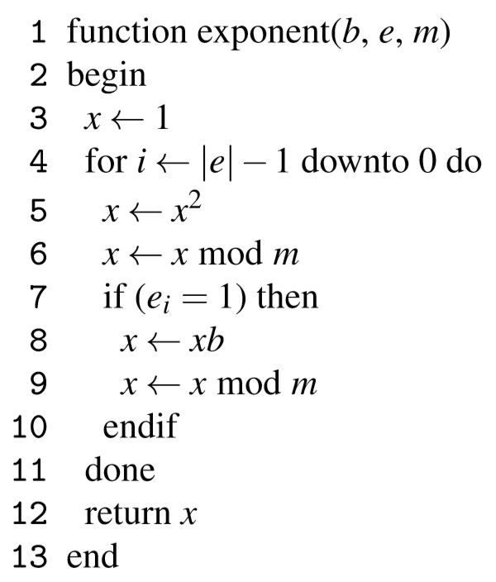
Square-and-Multiply

Slide 15
Square-and-multiply

Slide 16
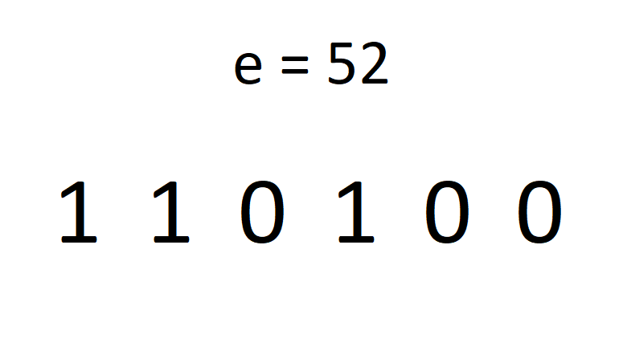
Square-and-multiply example

Slide 17
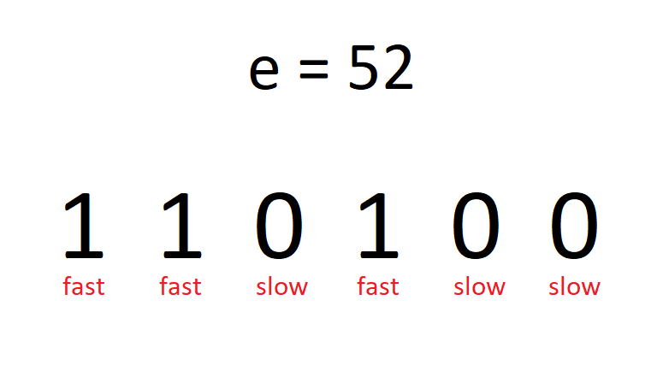
Square-and-multiply example

Slide 18
Flush + reload applications
Side-Channel Attacks on Everyday Applications: Distinguishing Inputs with FLUSH+RELOAD
Taylor Hornby

Slide 19


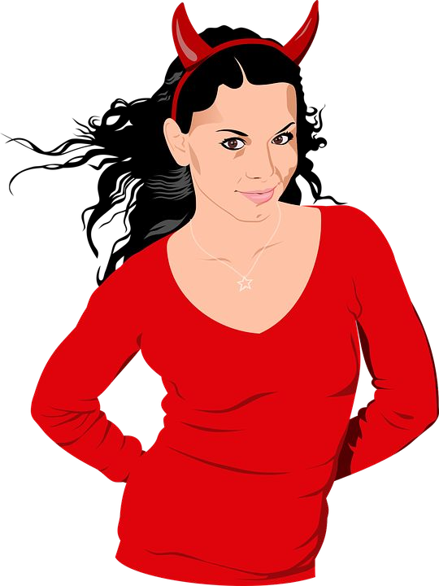


I need to
look up ear infections...
Strep, ear infection, or chickenpox?
SSH
Alice
Scarlet

Slide 20


Aha! Ear
infection!
Interesting.
EAR INFECTION
SSH
Unprivileged Spy Tool
Alice
Scarlet

Slide 21
Alice Virtual
DRAM
Flush+Reload by
Y. Yaram, K. Falkner.
RO

Slide 22
Alice Virtual
DRAM
Flush+Reload by
Y. Yaram, K. Falkner.
RO
Scarlet Virtual

Slide 23
Alice Virtual
CACHE
DRAM
Flush+Reload by
Y. Yaram, K. Falkner.
RO
Scarlet Virtual

Slide 24

Alice Virtual
CACHE
DRAM
Flush+Reload by
Y. Yaram, K. Falkner.
EIP
RO
Scarlet Virtual

Slide 25

Alice Virtual
CACHE
DRAM
Flush+Reload by
Y. Yaram, K. Falkner.
EIP
RO
Scarlet Virtual
READ
FAST

Slide 26
Alice Virtual
CACHE
DRAM
Flush+Reload by
Y. Yaram, K. Falkner.
EIP
RO
Scarlet Virtual
READ READ
FAST
SLOW

Slide 27

foo() {
...
Flush+Reload by
Y. Yaram, K. Falkner.
}
bar() {
...
}
baz() {
...
}

Slide 28

foo() {
...
Flush+Reload by
Y. Yaram, K. Falkner.
}
bar() {
...
}
baz() {
...
}

Slide 29
foo() {
...
Flush+Reload by
Y. Yaram, K. Falkner.
FLUSH
}
bar() {
...
}
baz() {
...
}
FLUSH
FLUSH

Slide 30
foo() {
...
Flush+Reload by
Y. Yaram, K. Falkner.
}
bar() {
...
}
baz() {
...
}

Slide 31
foo() {
...
Flush+Reload by
Y. Yaram, K. Falkner.
FLUSH
}
bar() {
...
}
baz() {
...
}
FLUSH
FLUSH

Slide 32
foo() {
...
Flush+Reload by
Y. Yaram, K. Falkner.
}
bar() {
...
}
baz() {
...
}

Slide 33
Aha! Ear
infection!
Interesting.
EAR INFECTION
SSH
Unprivileged Spy Tool
Alice
Scarlet

Slide 34
Put “light bulbs” on the HTML parser:
html_stack_item()
html_stack_dup()
html_a()
parse_html()

Slide 35
BDBCBCABABABACBABABCBABACBABCACABCBCACACABCABABCABCACABCBCABACACADBABDBCABDBCACB CABDBCABDBCABDBCABCABCBCBCABCACABDCBDBCBABABDCBDBCABDACBDBCBCBABABCBCABCACBCBCBA CBABACBACBABDBCABDBCABDBCABCBCBCBCABCABCBCABDABDCBCACBCACACBCABDABDBCABDBCABDBCB CABCABDBCABDBCABCABDBCABDBCABCABDBCABDBCABCABDBCABDBCABCABCBDBCABDBCABABDBCACBCA BCBCABCABDBDBCBCABCABDABDBCBCABCABCBCABCABCABDBCABDACBDBCABDBCABACBDBCABDBCABDCA BDBCBCABCACBCABCABDBCABCABDABCBCABDBCBCBABABCBCABCABCBCBCBABACABABACBABDACBDBCAB DBCABDBCBCABCBCABCBCABCABCBCABDBDBCBCABCABCABCACABDACBDCACBDCACBDBCBCACBCBCABDBC ABDBCACBCABDBCABDBCBCABCABDBCABCABDCABDCABCACBCBCABDADBCBCABDBCABCABCACBCACBCACA BDABDBCABCBCABCABDBCBCACBCBCABCABCABCABCBDBCABDBCABACBDBCABDBCABDBCABDBCABCABCAC BCABABCBCACBABCABDBDBCBCBCBACBABACBABCABCABCBCBCBCABABACBACBABCABDABCACBDABCABDA BCBCABACABCBCABABCABCBCABCBCABDABCBACACACABACABDBDBCABDBCABDBABCABCBCABDBACABDBA BCABACABACABDABCBACABCABDBCBACABDBACABDBABABCABCABCABABDBCBCABDABCABCBCBABCBCBAC ABDBCABCABCBCABDABCABCABCABCABACABCBCABD
A. html_stack_item()
html_stack_dup()
html_a()
parse_html()
Goal: Recognize this as the Ear Infection Wikipedia page.

Slide 36
Attack Stages:
Training - Scarlet spies on herself.
Spying - Scarlet spies on Alice.
Identification - Most similar by Levenshtein distance.

Slide 37
Stage 1: Training
Strep throat
Ear infection
Chickenpox

Slide 38
Stage 1: Training
Strep throat
Ear infection
Chickenpox

Slide 39
Stage 1: Training
Strep throat
Ear infection
Chickenpox

Slide 40
Stage 1: Training
Strep throat
Ear infection
Chickenpox

Slide 41
Stage 1: Training
Strep throat
Ear infection
Chickenpox

Slide 42
Stage 1: Training
Strep throat
Ear infection
Chickenpox

Slide 43
Stage 1: Training
Strep throat
Ear infection
Chickenpox

Slide 44
Stage 1: Training
Strep throat
Ear infection
Chickenpox

Slide 45
Stage 1: Training
Strep throat
Ear infection
Chickenpox

Slide 46
Stage 2: Spying
Strep throat
Ear infection
Chickenpox
?

Slide 47
Stage 3: Identification
Strep throat
Ear infection
Chickenpox
?

Slide 48
Stage 3: Identification
Strep throat
Ear infection
Chickenpox
!
Output: “Ear infection”

Slide 49
>90% Success
(100 pages, 10 samples)

Slide 50
It’s demo time.

